Slide 1
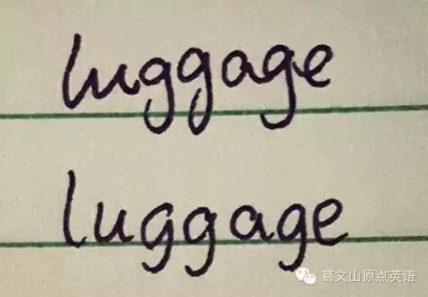
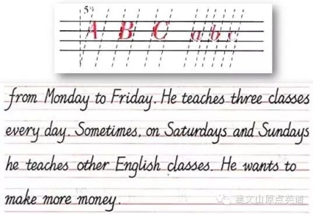
Calligraphy
1. just on the lines
2.inclination

Slide 2
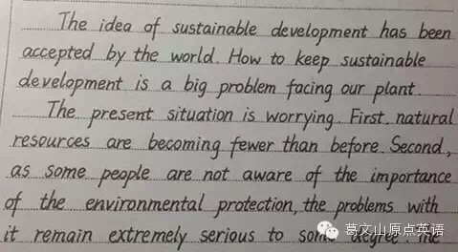
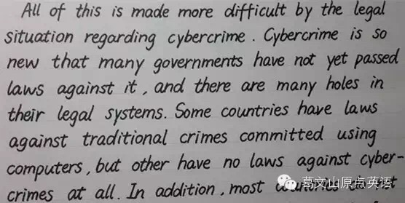
3. distance between words
4. distance between letters

Slide 3
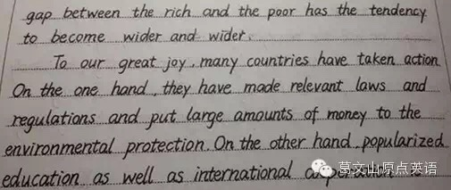
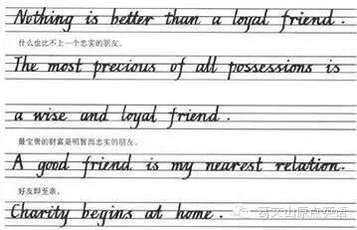
5. recognizable
6. same size

Slide 4
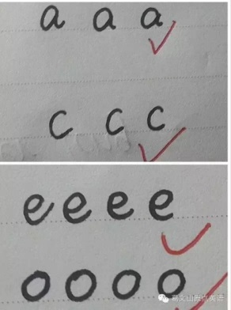
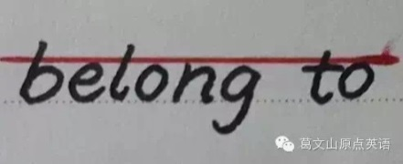
7. a, c, e, o, s
8. b, d, h, k, l
Notes:
7. Round enough
8. Their necks shouldn’t be too long.

Slide 5
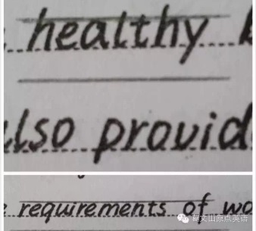
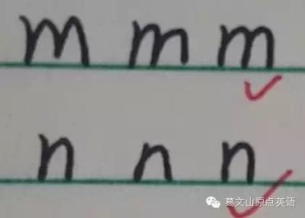
9. p, q, j, g, f, y
10. m, u, n
Notes:
9. Their tails should be short too.
10.

